Slide 1

AdriaFirePropagator – basic functionalities
Split - Dalmatia County
FESB University of Split

Slide 2

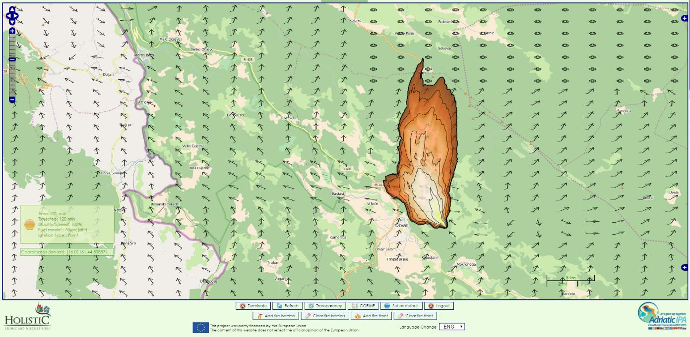
AdriaFirePropagator

Slide 3
AdriaFirePropagator
Fire simulations from within AdriaFireGIS

Slide 4
AdriaFirePropagator
AdriaFirePropagator user interface

Slide 5
AdriaFirePropagator
Starting simulations based on current conditions

Slide 6
AdriaFirePropagator
Simulation settings

Slide 7
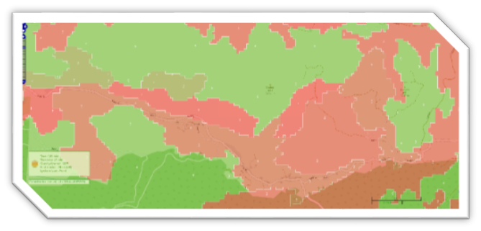
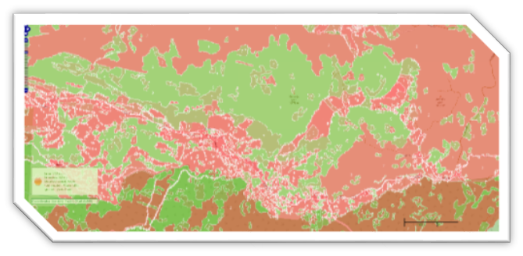
AdriaFirePropagator
Fuel maps:
    Default fuel maps:
      Albini-Anderson’s 13 fuel categories
      Scott-Burgan’s 40 fuel categories
    Custom user maps:
      Albini-Anderson’s 13 customizable fuel categories
      Scott-Burgan’s 40 customizable fuel categories

Slide 8
AdriaFirePropagator
Fuel maps:
    Default fuel maps:
      Precalculated once for the whole region
      Based on CORINE land cover land use
      Based on default conversion tables
        CORINE -> Albini-Anderson’s (13 categories)
        CORINE -> Scott-Burgan’s (40 categories)
      Shared between all users
      Users cannot change/modify default fuel maps in any way

Slide 9
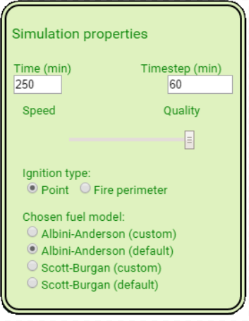
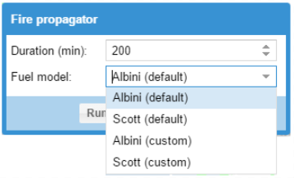
AdriaFirePropagator
Fuel model = fuel map + fuel parameters

Slide 10
AdriaFirePropagator

Slide 11
AdriaFirePropagator
Fuel parameters:
    1-h Fuel Load
    10-h Fuel Load
    100-h Fuel Load
    Live Herbaceous Fuel Load
    Live Woody Fuel Load
    1-h Surface Area/Vol Ratio
    Live Herbaceous Surface Area/Vol Ratio
    Live Woody Surface Area/Vol Ratio
    Fuel Bed Depth
    Dead Fuel Moisture of Extinction
    Dead Fuel Heat Content
    Live Fuel Heat Content

